Slide 1
Goals (at least my goals)
Assemble genome
Find sex marker
Estimate effective population size

Slide 2
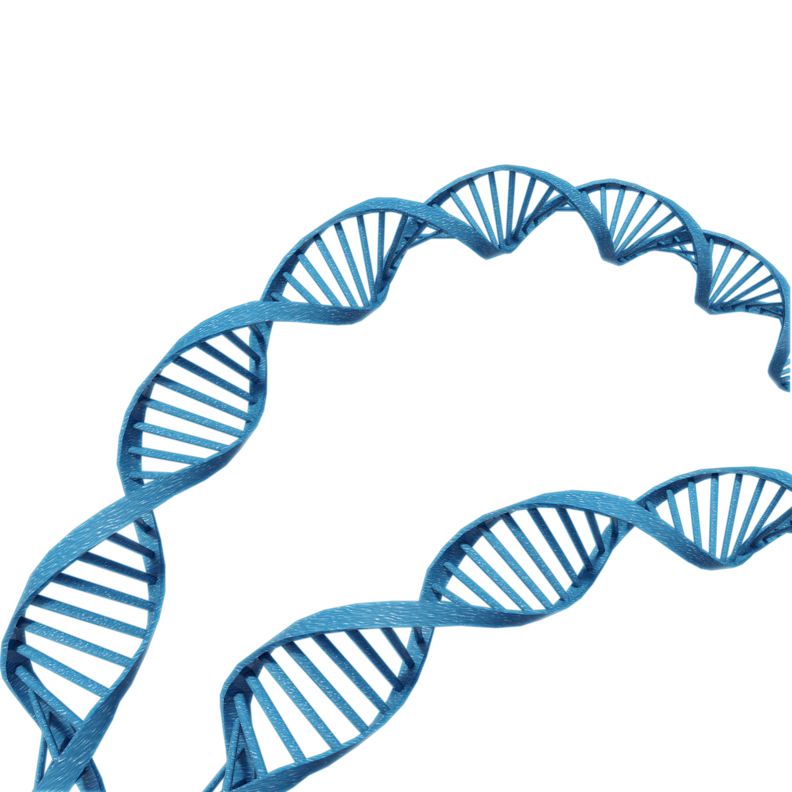
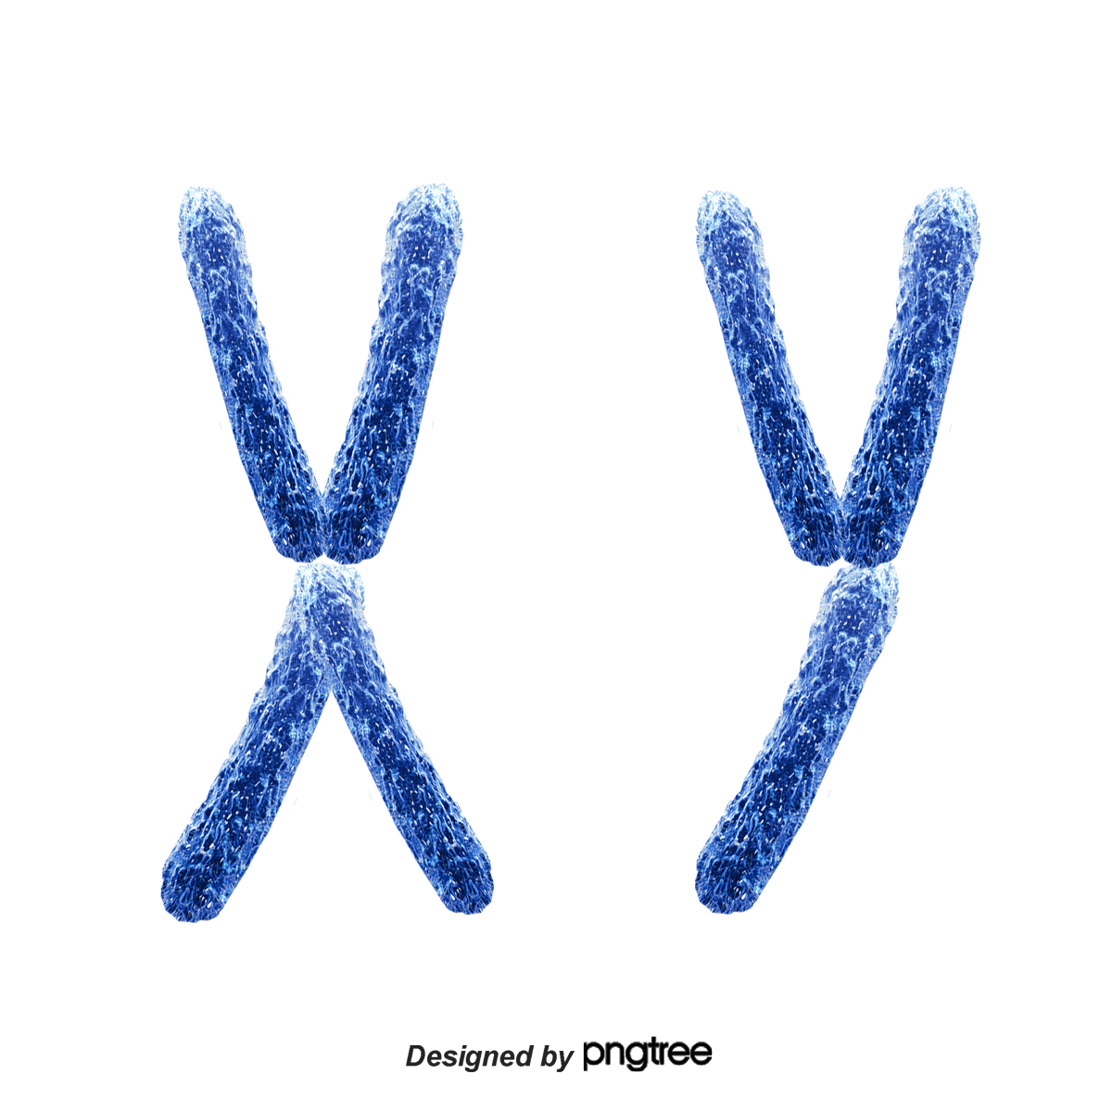
Genomes are very large
cell
nucleus
genome
A
T
T
C
G
T
C
G
A
C
C
G
G
T
A
A
C
G
A
A
Notes:
Human genome over 3 billion base pairs long

Slide 3
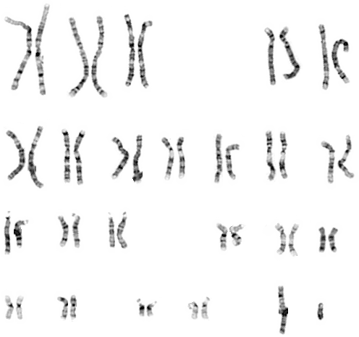
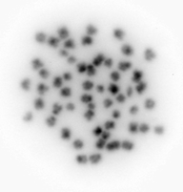
Our first step was to determine how many chromosomes to expect when assembling the Delta Smelt genome
Performed a karyotyping study in collaborations with Dr. Mary Delaney
Delta Smelt have 28 chromosomes
high resolution human karyotype

Slide 4
Next: capture all of the genome by using multiple types of sequencing technologies
Use more current sequencing technology to create a high-quality genome assembly
long reads
hi-c
A
T
T
C
G
T
C
G
A
C
C
G
G
T
A
A
C
G
A
A
linked reads
Notes:
State chromosome level assembly means that our assembly is divided into chromosomes

Slide 5
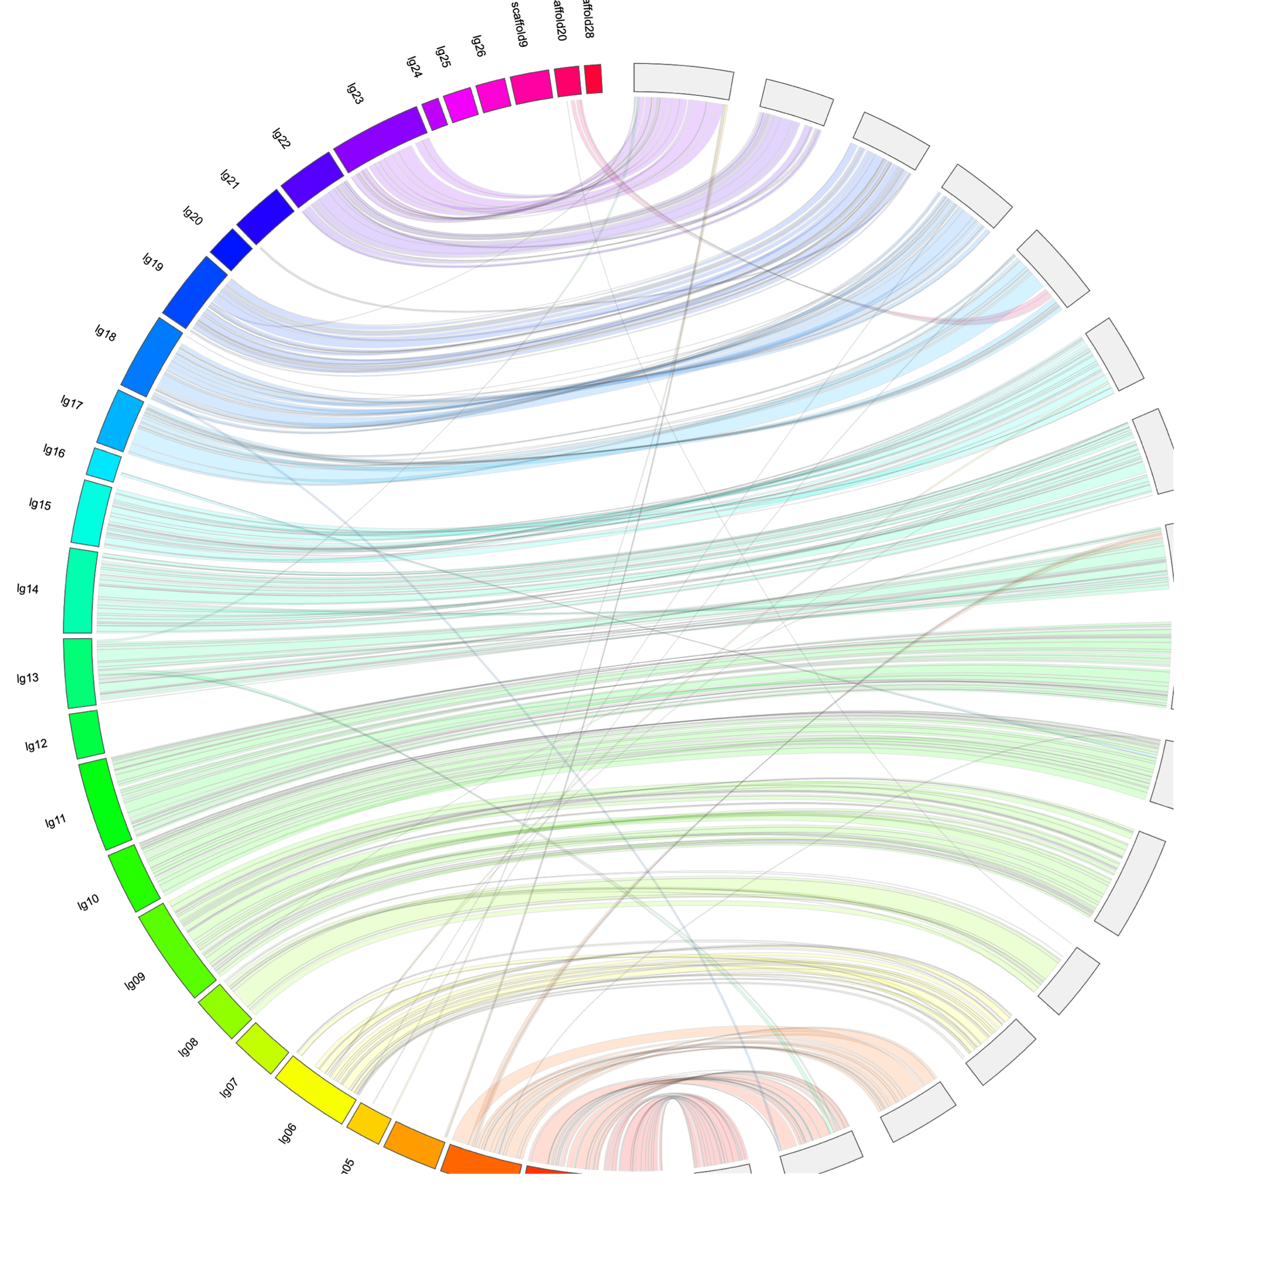
We achieved two high quality assemblies
MALE
FEMALE
One Male
One Female
Each sex assists in validating the other assembly
Notes:
Talk about the figure and how it shows diff in M and F
The figure on the right is a circular plot with the assembled male chromosomes (or volumes of books) on the left and the female chromosomes on the left. The strings spanning from the female to male assembly identify areas that are the same between the two assemblies. So we can see regions that appear to be assembled the same in the two sexes. And regions that we need to manually look into to resolve if they are correct in the male or female assembly.
Explain what a karyotype is and how we got it, and how we got photograph, and what is in each of the blobs
Better explains the figure\

Slide 6
We achieved two high quality assemblies
MALE
FEMALE
One Male
One Female
Each sex assists in validating the other assembly
Misassemblies
Notes:
Talk about the figure and how it shows diff in M and F
The figure on the right is a circular plot with the assembled male chromosomes (or volumes of books) on the left and the female chromosomes on the left. The strings spanning from the female to male assembly identify areas that are the same between the two assemblies. So we can see regions that appear to be assembled the same in the two sexes. And regions that we need to manually look into to resolve if they are correct in the male or female assembly.
Explain what a karyotype is and how we got it, and how we got photograph, and what is in each of the blobs
Better explains the figure\

Slide 7
We achieved two high quality assemblies
MALE
FEMALE
One Male
One Female
Each sex assists in validating the other assembly
Misassemblies
Placing sequences
Notes:
Additionally, we can also identify unassembled sequences to incorporate into the chromosoms.

Slide 8
How does this genome help?
Reference genomes are necessary to compare individuals’ DNA
Must know that we are comparing apples to apples
Before we used a RAD-sequencing based reference genome
RAD sequencing
Notes:
RAD assembly is created from a few random individuals’ very short DNA sequences located throughout the genome.
If the blue line is a segments of the true genome of Delta Smelt RAD gives us data at these red points.
RAD give us about 3-600 base pairs of sequences scattered throughout the genome.
You can imagine that with a genome length of 500 million we would get a lot of those little chunks back.
Unfortunately, we cannot connect these sequences to one another, so what we end up getting looks is something like this:

Slide 9
How does this genome help?
Reference genomes are necessary to compare individuals’ DNA
Must know that we are comparing apples to apples
Before we used a RAD-sequencing based reference genome
RAD sequencing
Notes:
So not only do we not know where these segments lie in relation to one another, we have captured relatively little of the genome

Slide 10
Our new assembly is much more contiguous.
Estimated genome size = 465 Mbp
 | RAD Assembly | New Assembly
Assembly Length | 12,905,745 bp | 437,273,953 bp
% of Estimated Genome | 2.58% | 94.4%
Average Length | 472 bp | 1,162,963 bp
Number | 27,297 | 376
New Assembly
DNA segment

Slide 11
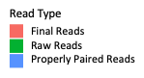
RAD assembly metrics
Birth Year | Average Alignment | Birth Year | Average Alignment
1993 | 35.3% | 2007 | 80.8%
1995 | 74.5% | 2008 | 80.8%
1996 | 69.6% | 2009 | 79.7%
1997 | 65.7% | 2010 | 78.0%
1998 | 70.7% | 2011 | 77.7%
1999 | 74.0% | 2012 | 77.7%
2000 | 70.3% | 2013 | 77.0%
2002 | 81.4% | 2014 | 77.6%
2004 | 81.2% | 2015 | 78.8%
2006 | 80.9% | 2016 | 78.7%
 |  | All Years Combine | 78.0%
number of individuals
number of reads
Notes:
X axis is the number of DNA of sequences (or reads) from each individual
Y axis is how many individuals with that number of reads
So, we can see that the number of reads sizably decreased from their “raw” or unaligned state in green, to their aligned state in pink.
The lack of aligned reads is something that may lead to technical issues as we are not getting all of the information that we can from our data.
To get reliable estimates in our analyses we can only use SNPs that align from all of our individuals –– over 20% of reads didn’t align to our de novo RAD seq based assembly

Slide 12
Alignments improved with with the new assembly
 | RAD Assembly Alignments | New Assembly Alignments
All Years Combine | 78.0% | 92.6%
Notes:
As one might expect with a more continguous genome we are seeing much better alignment statistics when we use our new reference genome.

Slide 13
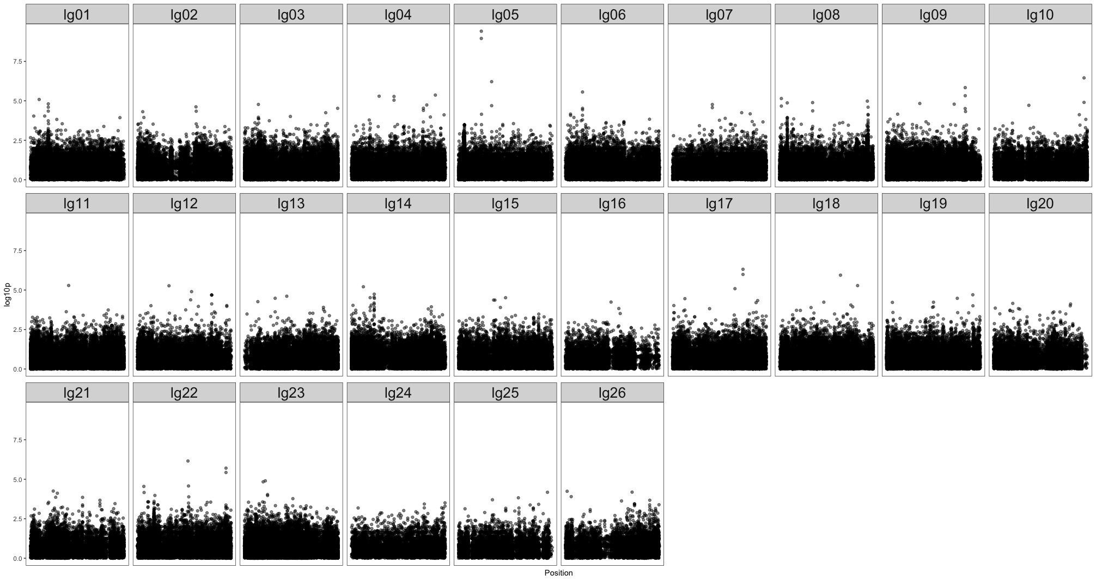
What we’ve already done with the genome
Sex Marker
Association Study

Slide 14
Estimate the effective population size of wild delta smelt
Effective population size (N_{E}) determines how quickly populations are losing genetic diversity
50:500 rule
Can look at historical or contemporary N_{E}
Historical N_{E} is usually fairly stable
Contemporary N_{E} can give the effective population size of just a few generations back
Notes:
50:500 doesn’t apply to aquatic populations at well (generally used for terrestrial mammalian populations)
Definition: the number of individuals that an idealized population would need to have in order for a specified quantity of interest to be the same in the idealized population as in the real population
Genetic diversity is really important for populations to persist. New diversity comes from mutation so when you have a really small population you won’t see
Covid population is so huge so you get a bunch of mutation and the virus can adapt and respond to new environments
Larger population has greater genetic diversity, smaller populations have less genetic diversity
A common rule of thumb is the 50:500 rule––wild populations need to have a Ne of 500 to persist
Historical Ne is fairly stable unless there is a massive alteration to a population
Markers can’t be close together

Slide 15
Historical datasets
2208 wild fish from 1993 – 2016
RAD sequencing for each fish
Our initial estimates used the RAD Assembly
Notes:
First pass on effective population size just using RAD data
Simplify––we had a big dataset but without the reference genome analysis was suboptimal

Slide 16
Historical N_{E} using RAD assembly
Notes:
We didn’t have a genome assembly so Y-axis is very unreliable due to the noise from not having an assembly

Slide 17
Contemporary N_{E} using RAD assembly
Notes:
Walk through slides
Talk about numbers!
We might expect this if a population shrinks
In order to accurately estimate Ne we needto make sure that markers are on separate chromosomes and are not dependent on one another––they need to not me physically close to each other

Slide 18
Next steps
Improve genome
Re-estimate effective population size (1993-2016)
Analyze new data from 420 wild fish (2017 – 2018)
Further investigate sex marker
Finish PhD, get vaccinated and take a vacation
Notes:
2 fish where we sequenced the entire genome with complete resolution––interrogating 500 million positions in the genome very thoroughly
Had over 2500 samples where we sequenced with more sparse coverage––probably interrogating less than a million positions

